Slide 1

Modeling Pitch Velocity Differences
An Exploratory and Predictive Analysis of MLB Pitch Data (2020-2024)
By Kaleb Jordan

Slide 2

Project Motivation
What is velocity gap?
The velocity differential is the difference between a pitcher's average fastball and each of their breaking ball pitch averages.
Why does it matter?
The velocity gap can disrupt a hitter's timing.
Pitchers can have deceptive velocity changes, ultimately being more effective.
What is the goal?
Predict velocity gaps based on mechanics and usage features
Identify trends, patterns, and outliers

Slide 3
Data Overview
Approximately 3 million observations and 36 variables of pitch data collected from the 2020-2024 MLB seasons
Variables include release velocity, spin, break, release, extension, and location
Removed non-mechanical variables (i.e., exit velocity or launch angle)
Used listwise deletion methodologies where feasible
For more important variables such as spin rate and spin direction, imputation via linear regression was used for each specific season

Slide 4
Feature Engineering
Means and variability (quantile ranges) for:
Spin rate & direction
Break (x & z)
Release & location
Extension, approach angles
Usage metrics: Fastball % and Breaking ball %
Role: Starter vs. Reliever (based on inning appearance)

Slide 5
Modeling Approach
Primary Model:
Linear Regression
Interactions: pitch type × break characteristics.
Checked multicollinearity (VIF OK).
Why Linear Regression?
Strong interpretability.
Relationships expected to be mostly linear with modest interactions.
Other Models Tested:
Random Forest and Gradient Boosting (GBM) for comparison.
Variable | Generalized Variance Inflation Factor
Mean Break Z | 4.75
Mean Release Z | 1.10
Fastball Average Velocity | 1.37
Pitch Type x Mean Induced Break Z | 1.68
Mean Break Z x Mean Induced Break Z | 8.677

Slide 6
Model Performance
Model | Train RMSE | Test RMSE | Train MAE | Test MAE
Linear Regression | 0.409 | 0.428 | 0.286 | 0.291
Random Forest | 0.486 | 1.113 | 0.364 | 0.864
GBM | 0.418 | 0.664 | 0.330 | 0.506
Key Insight:
Linear regression outperformed both models in generalization (lower test error, no overfitting).

Slide 7
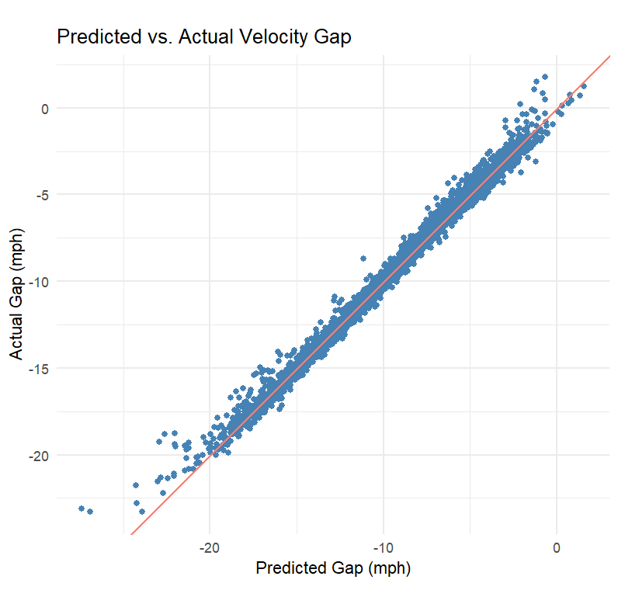
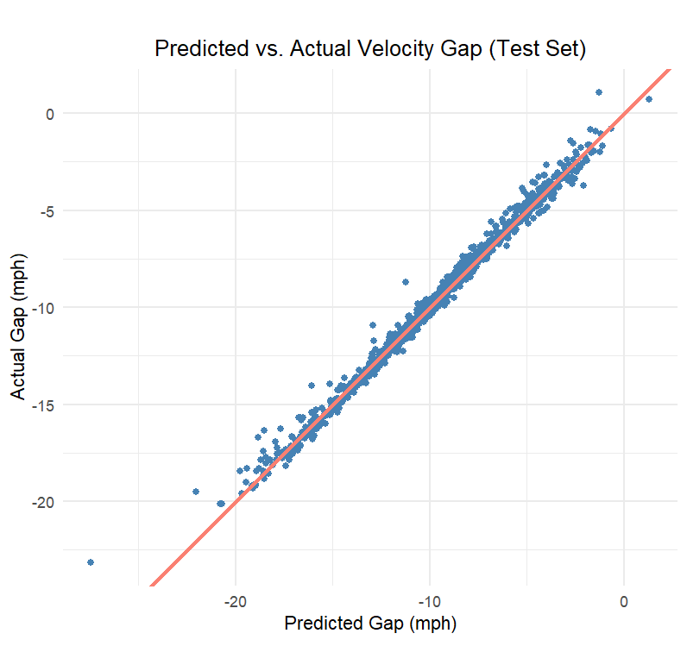
Train and Test Predictions

Slide 8
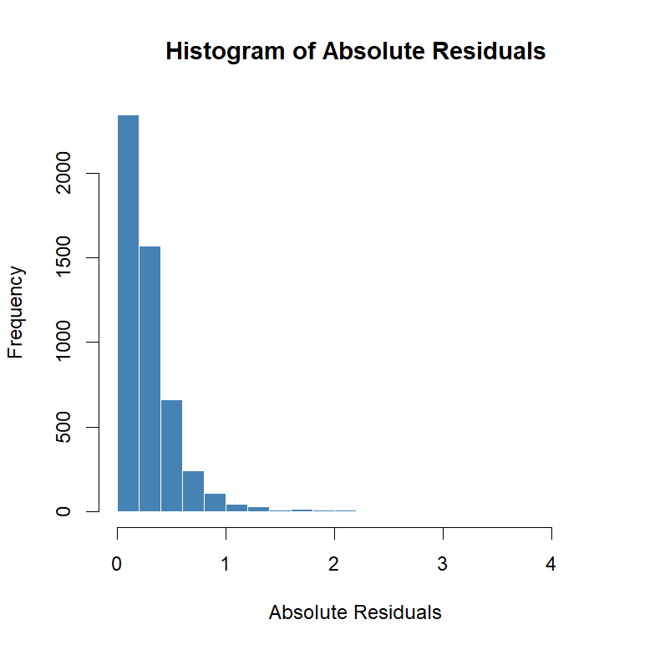
Residual Analysis
99% of absolute residuals under 1.33 mph.
Outliers mainly pitchers with:
Extreme variability.
Deliberate speed deception.

Slide 9
Shiny App Development
Why an App?
Static charts don’t allow exploration.
Pitching coaches, analysts, and researchers need flexibility.
App Features:
Filter by pitcher, season, and pitch type.
View predicted vs. actual gaps.
Analyze residuals interactively.

Slide 10
What Can We Learn?
Evaluate pitch consistency and deception.
01
Monitor how pitchers evolve over seasons.
02
Flag when greater variability might be beneficial (deception) or harmful (control issues).
03
Identify candidates for pitch development (e.g., pitchers with low natural gaps).
04

Slide 11
Takeaways
Conclusions:
Simple, interpretable models can outperform complex methods for structured data.
Pitch mechanics and variability are powerful predictors of velocity gaps.
Interactive tools (Shiny apps) make the analysis actionable and transparent.
Future Work:
Add batter matchup data.
Include in-game context (count, leverage).
Model how gaps evolve during seasons.

Slide 12
Thank You!

